Slide 1
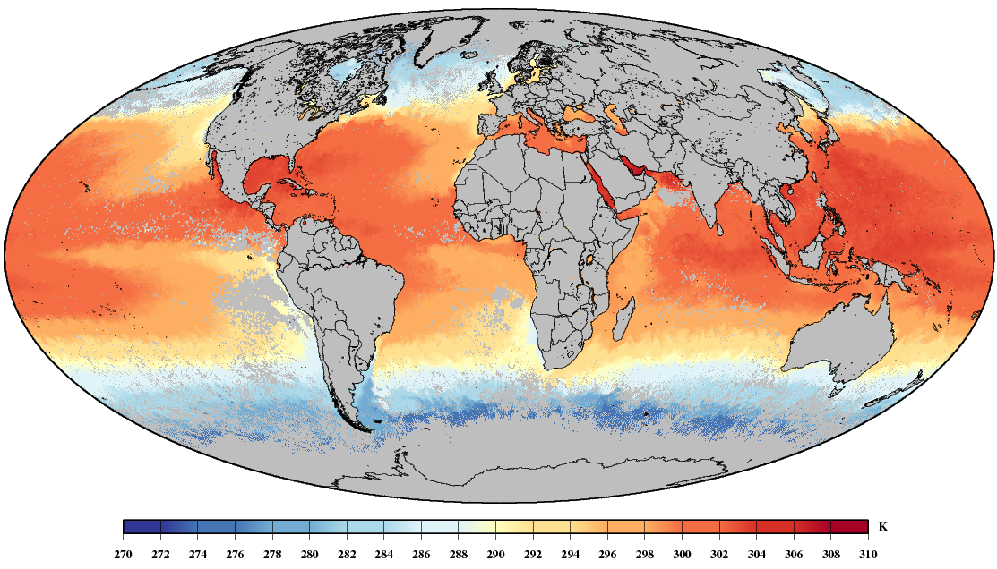
A full physics algorithm to retrieve nighttime sea surface temperature with IASI: Toward an independent homogeneous long time-series for climate studies
Virginie Capelle, Jean-Michel Hartmann, Cyril Crevoisier

Slide 2
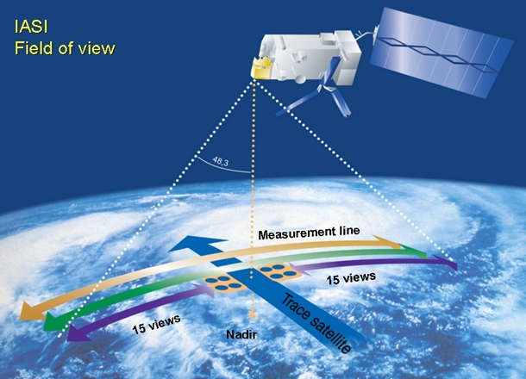
SST is an essential climate variable
key parameter in the long term monitoring of the climate evolution
The knowledge of its geographical and time variations is essential in the climate models
IASI can provide valuable contribution thanks to its planned long time series and its exceptional stability of both the spectral and radiometric calibrations
2006
2012
2018
2023
2030
2037
IASI/
Metop-A
IASI/
Metop-B
IASI/
Metop-C
IASI-NG/Metop-SG
IASI-NG/MetopSG-B
IASI-NG/MetopSG-C

Slide 3
Quality requirement
﻿for advanced climate applications
﻿Minimum length of record : 15 years
Precision: better than 0.1K
stability: better than 0.05K.decade-1
Homogeneity : ﻿Inconsistencies between sensors <<0.1 K.
independency from other dataset :
To allow independent validation
To confirm (or not!) any observed evolution of the temperature
Ohring et al, Bull. Am. Meteorol. Soc., 2005; Merchant et al., Advance in Space Science, 2008; O’Carroll et al., Front. Mar. Sci , 2019,

Slide 4
Retrieval scheme
Objective: Provide a full physics retrieved SST, independent of in-situ measurements or models.
$$T_{s}=B^{−1}\left(\frac{I_{sat}−\sum_{k=1}^{s}{B_{k}\left(τ_{k}−τ_{k+1}\right)−(1−ε_{s})τ_{s}\sum_{k=1}^{s}{B_{k}}}\left({τ^{′}}_{k}−{τ^{′}}_{k+1}\right)}{ε_{s}τ_{s}}\right)$$
Procedure:
Clouds screening (using only IASI BT and AVHRR BT)
Transmissions (T and H2O profiles) constrained by a proximity recognition in radiances within the TIGR climatological dataset`
Surface temperature is estimated from the RTE for channels with high surface transmission (τs>0.9)
SST is then averaged for all the channels selected
=> The selection of channels used is crucial
Capelle et al., RSE, accepted

Slide 5
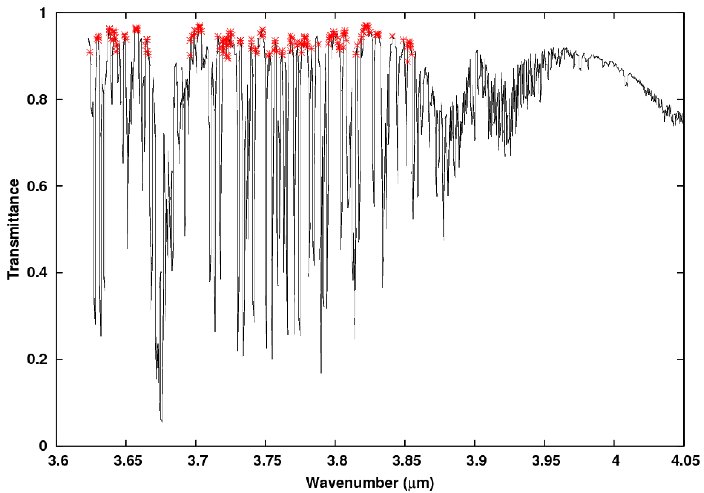
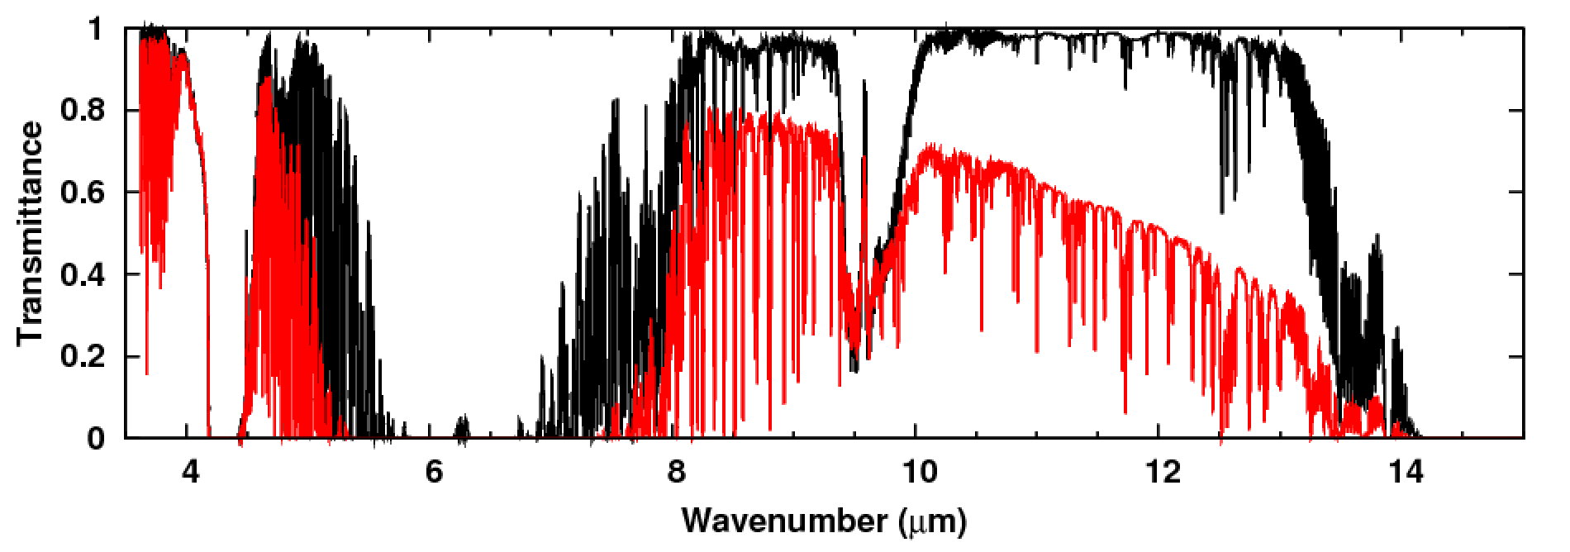
Channels selection
Only highly transparent channels are used (τs>0.9)
avoid errors due to the limited knowledge of the T and H₂O profiles and/or of the H₂O continuum
185 channels selected in the region 3.92-3.62µm (2550-2760cm⁻¹)
The average made over these channels reduces drastically the radiometric noise
Surface transmission
Polar
Tropical

Slide 6
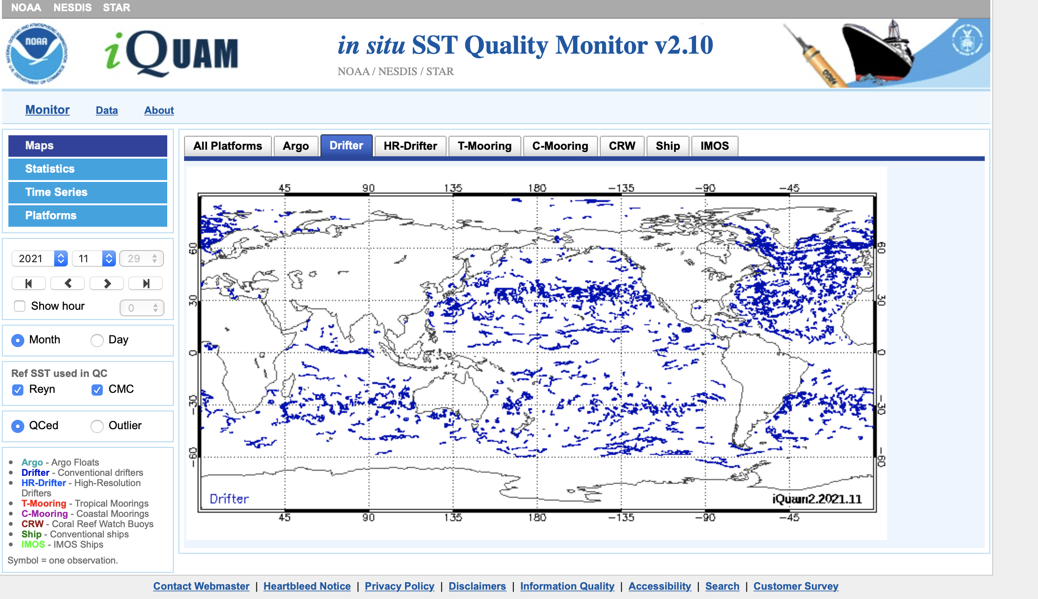
Validation against drifters
The whole IASI observations have been processed:
Metop-A from June 2007
Metop-B from February 2013
Metop-C from July 2019
Collocations with drifters for validation:
Distance < 20 km
Time shift < 3h
Best quality for drifters
=> Bias and standard deviation analysis of the difference T_{IASI}-T_{drifters}
ttps://www.star.nesdis.noaa.gov/

Slide 7
Validation against drifters (1/4)
Compare T_{IASI} against T_{drifter} is not straightforward!
IASI sensitive to the skin temperature
Drifters measure the depth temperature (~0.2m)
A parametrization of the skin-to-depth temperature difference is required for analyzing biases
Depends on the conditions of observation (wind speed, thermodynamic conditions, etc…).
Here we use a parametrization of Fairall et al., 1996 forced by the ERA5 surface flux and the friction velocity.
Donlon et al., 2007

Slide 8
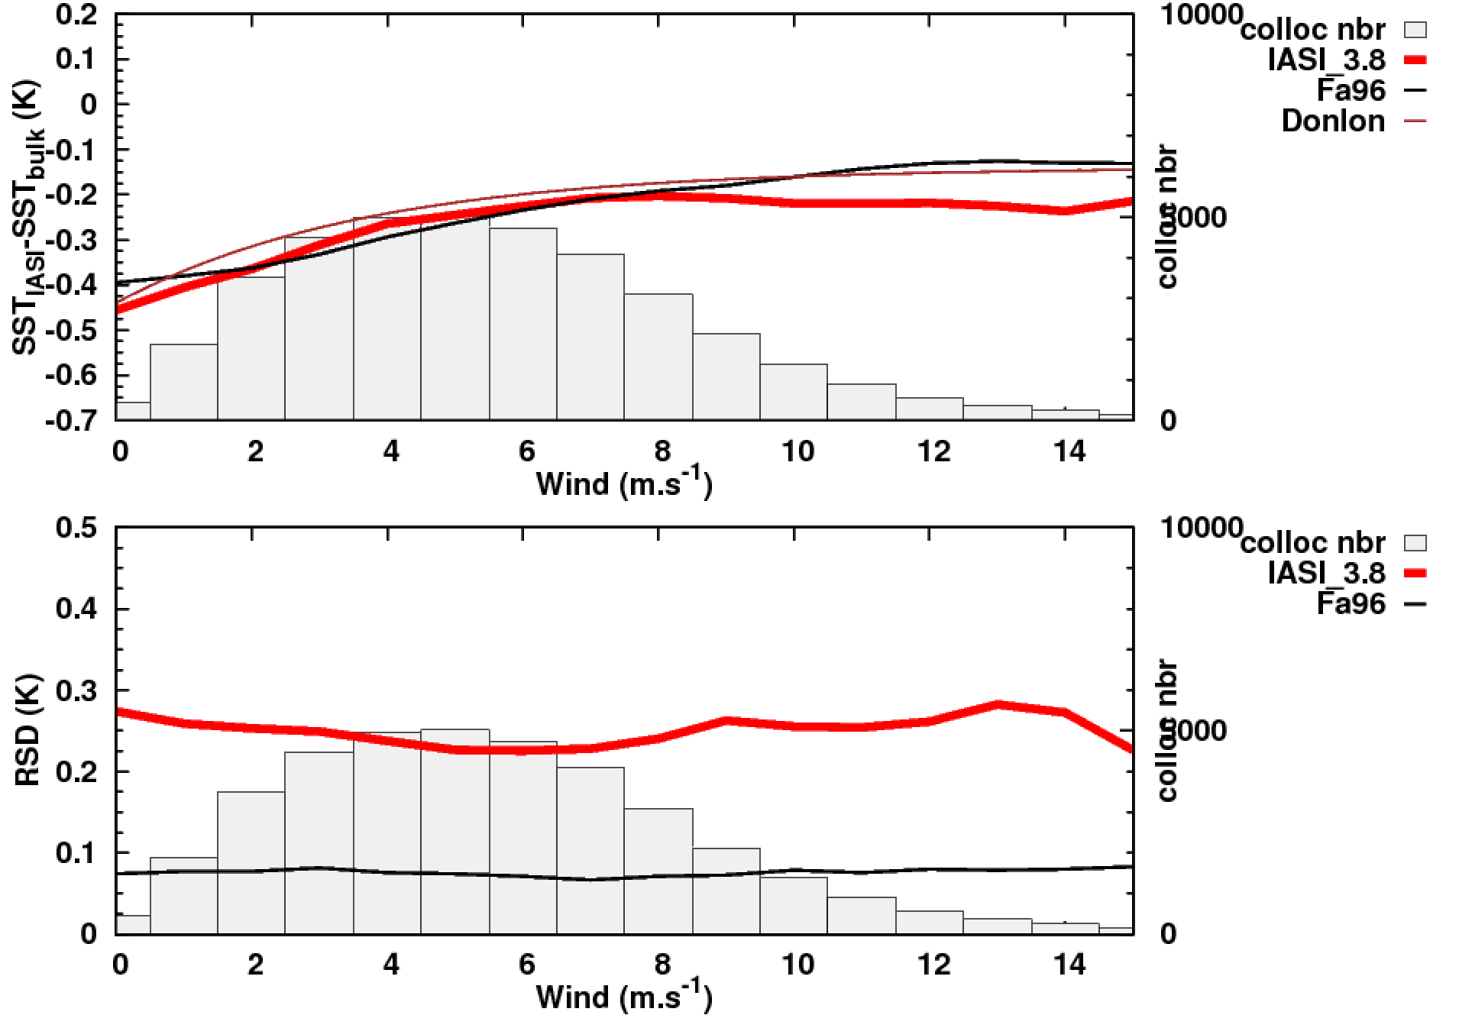
Validation against drifters (2/4)
Evolution of the skin-to-depth temperature difference (ΔT) with wind speed:
=> To the first order, ΔT depends principally on wind speed
IASI_3.8 : SST IASI LMD
FA96 : theoretical model (Fairall et al. 96) forced by ERA5 forcast
Donlon: empirical law obtained from ships measurements(Donlon et al., 2002)
Collocations for 2016

Slide 9
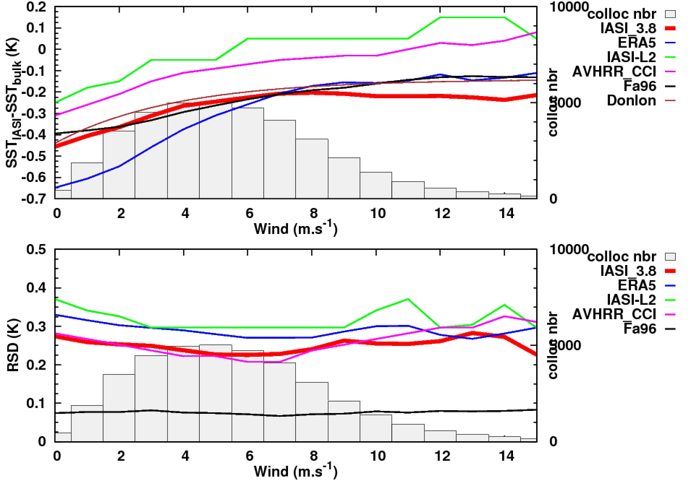
Validation against drifters (3/4)
Evolution of the skin-to-depth temperature difference (ΔT) with wind speed:
=> To the first order, ΔT depends principally on wind speed
Comparison with other products
IASI_3.8 : SST IASI LMD
FA96 : theoretical model (Fairall et al. 96) forced by ERA5 forcast
Donlon: empirical law obtained from ships measurements(Donlon et al., 2002)
ERA5 : ERA5 skin temperature
IASI-L2 : operational product
AVHRR_CCI : AVHRR/Metop-A L3C from ESA_CCI
Collocations for 2016

Slide 10
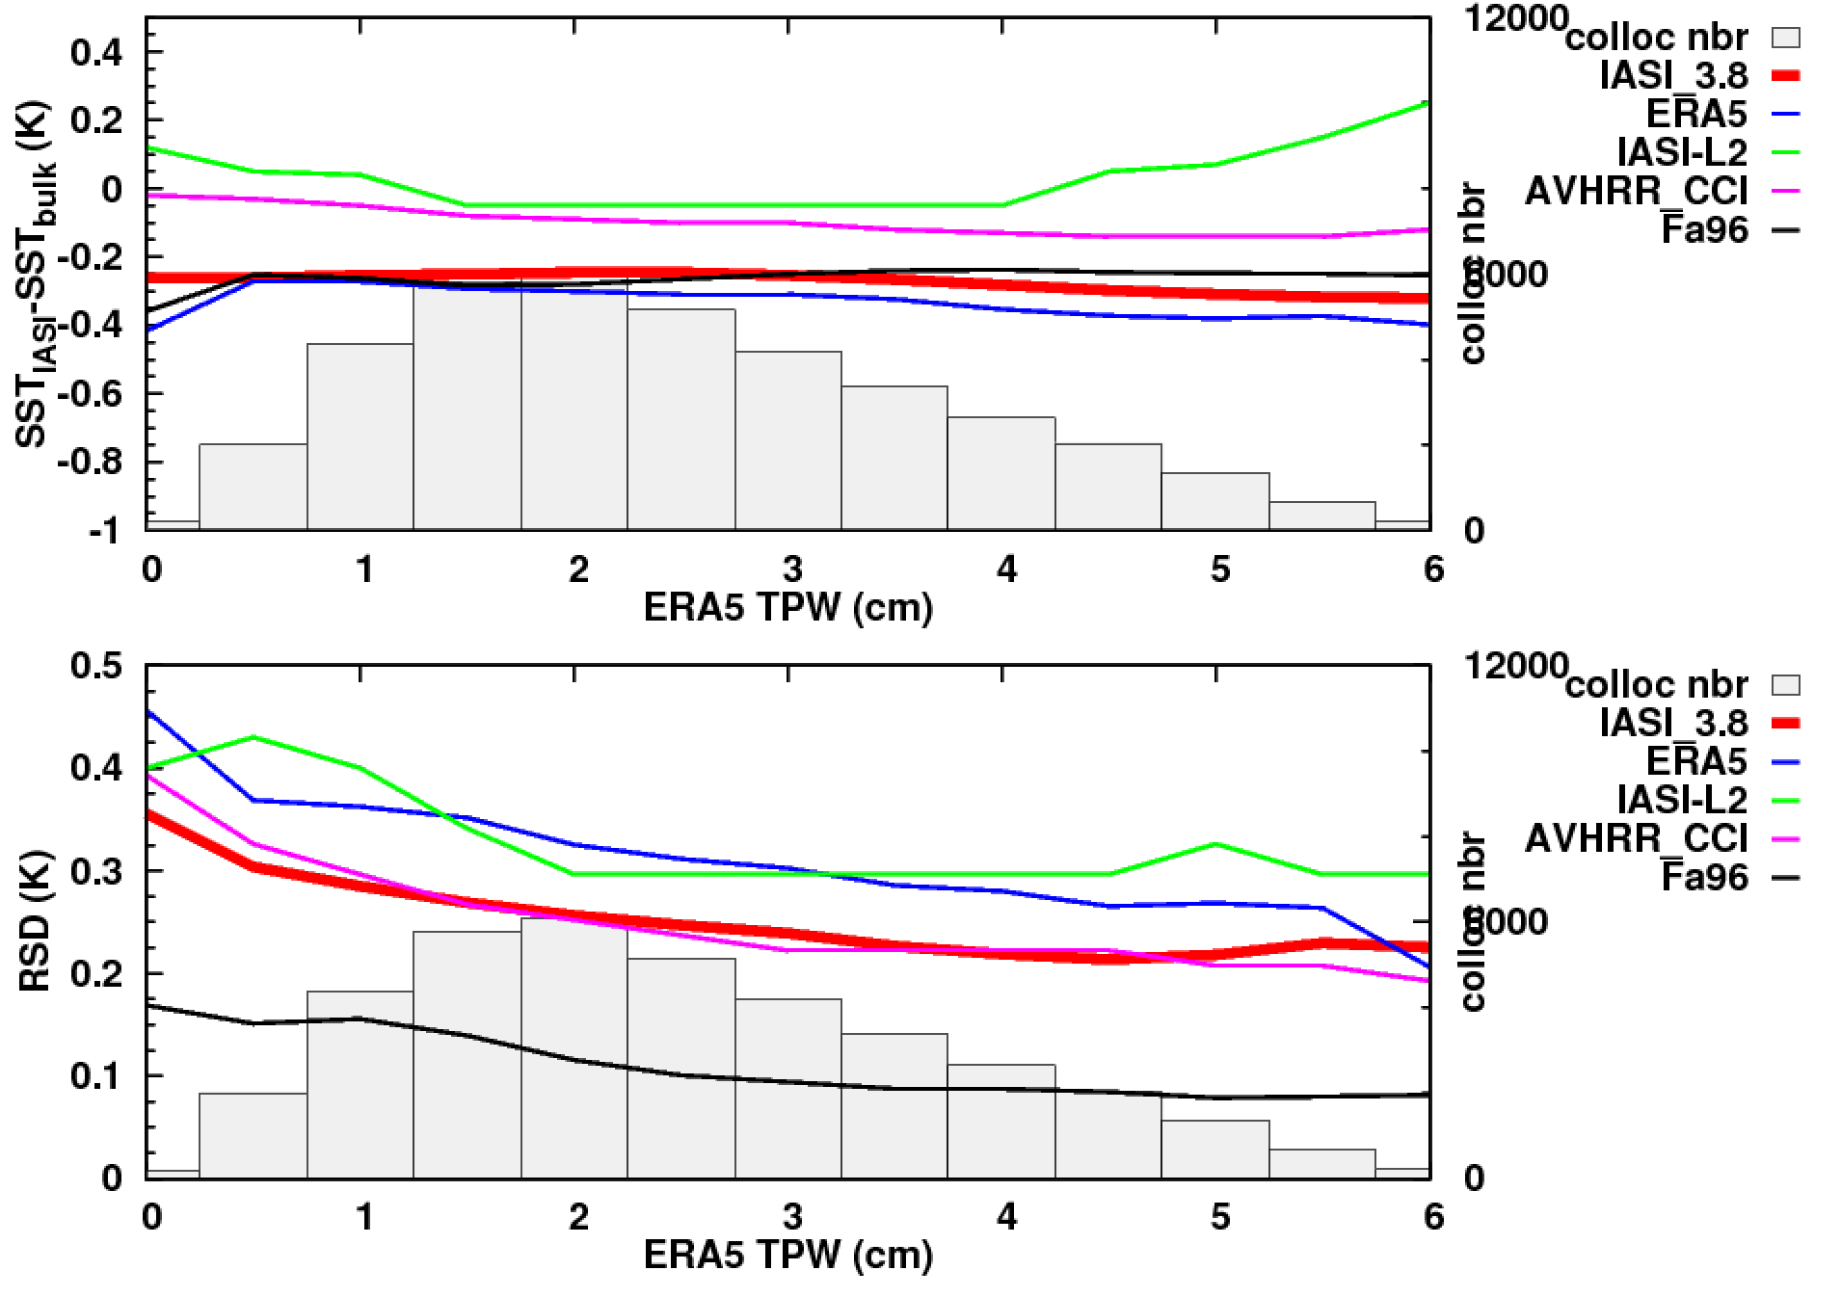
Validation against drifters (4/4)
Evolution of the skin-to-depth temperature difference (ΔT) with the water vapor content: => ΔT must be almost insensitive to TPW
IASI_3.8 : SST IASI LMD
FA96 : theoretical model (Fairall et al. 96) forced by ERA5 forcast
Donlon: empirical law obtained from ships measurements(Donlon et al., 2002)
ERA5 : ERA5 skin temperature
IASI-L2 : operational product
AVHRR_CCI : AVHRR/Metop-A L3C from ESA_CCI
Collocations for 2016

Slide 11
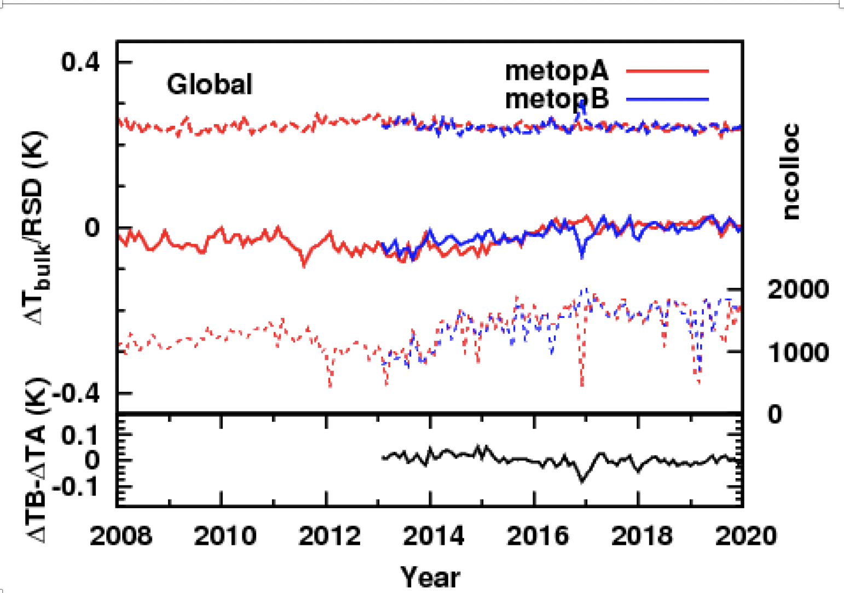
Stability assessment of metop-A/metop-B
Here the IASI skin temperature is converted to depth temperature following Fairall et al., 96
General statistics over all the period:
Small bias between IASI and drifter :
Metop-A (2008-2020):
median=-0.03K; RSD=0.25K
Metop-B (2013-2020):
median= -0.02K; RSD=0.24K
(drifters precision : ~0.2K)
RSD
median
Collocations number

Slide 12
Stability assessment of metop-A/metop-B
Here the IASI skin temperature is converted to depth temperature following Fairall et al., 96
Evolution of △T with time
Stable bias with time but small change between 2014 and 2016 observed by both Metop:
Global variation of the bias for metop-A: 0.045K.decade⁻¹ (95%=0.011K.decade⁻¹ )
Variation over the Tropics: 0.024K.decade⁻¹ (95%=0.012K.decade⁻¹ )
Small and stable bias between Metop-A et Metop-B (~0.002K)
RSD
median
Collocations number

Slide 13
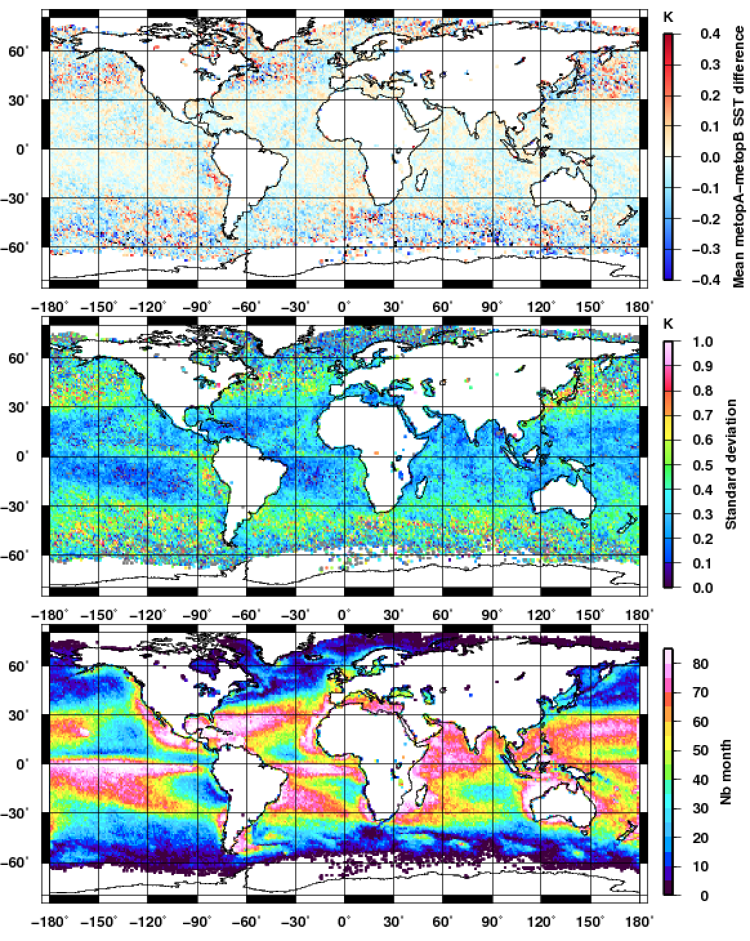
Homogeneity of the metop suite
Averaged of Metop-A – Metop-B monthly 1°x1° grids differences over the 2013-2020 period
Comparison month per month over monthly 1°x1° grids
Overall robust statistics
Mean
Metop | B-A (2013-2020) | C-A (2019-2020) | C-B (2019-2020)
Median (K) | ﻿-0.004K | -0.03 | -0.02
RSD (K) | 0.25K | 0.16 | 0.23
SD
High consistency between every Metop
No particular geographic bias
Metop-A time series can be extended with Metop-B without discontinuity in the time series
Similar conclusion between Metop-B and Metop-C
Nmonth (max=84)

Slide 14
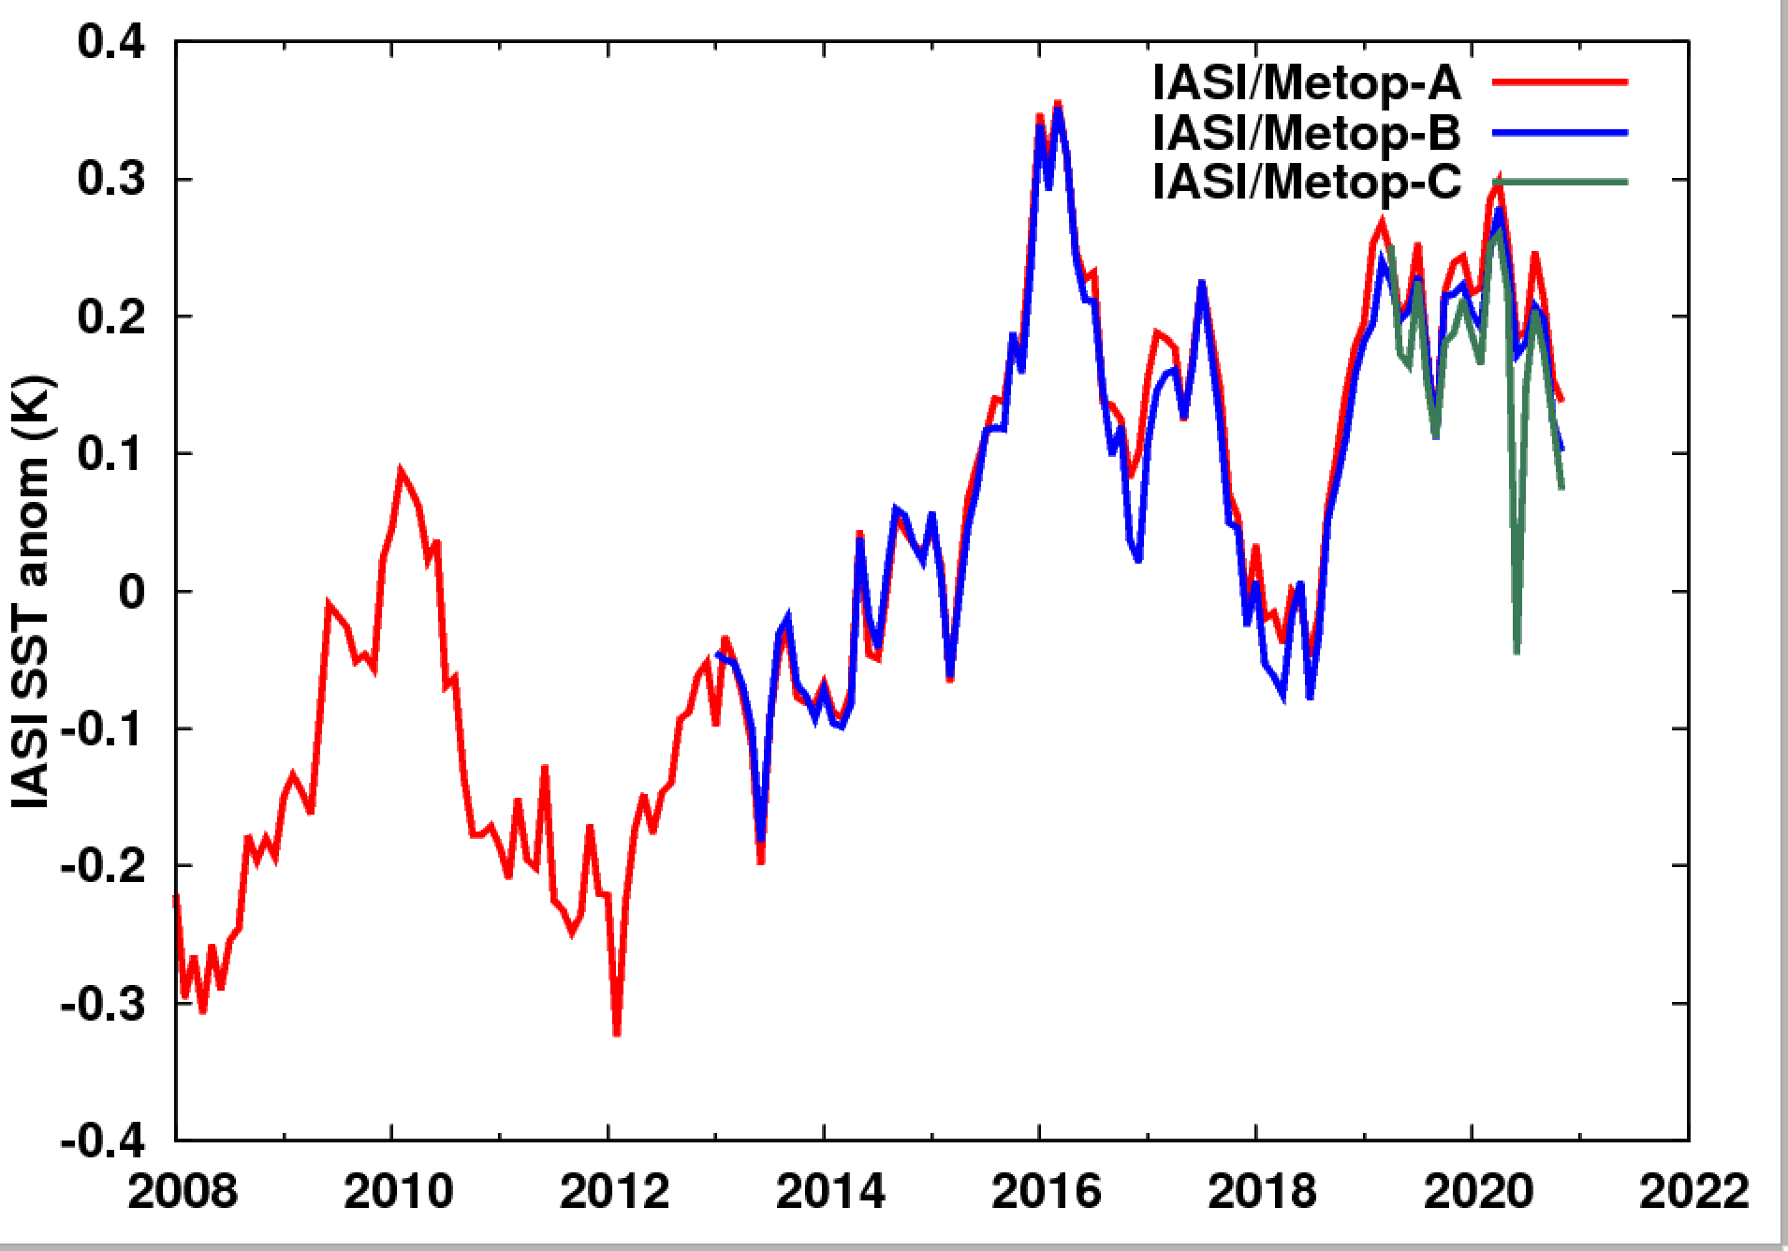
Evolution of the sea surface temperature over the 2007-2020 period
Metop series continuity
high consistency between the 3 metop
Regular increase of the temperature since 2008: +0.4K
Global temperature anomaly time series
(ref: metop A sur 2008-2020)

Slide 15
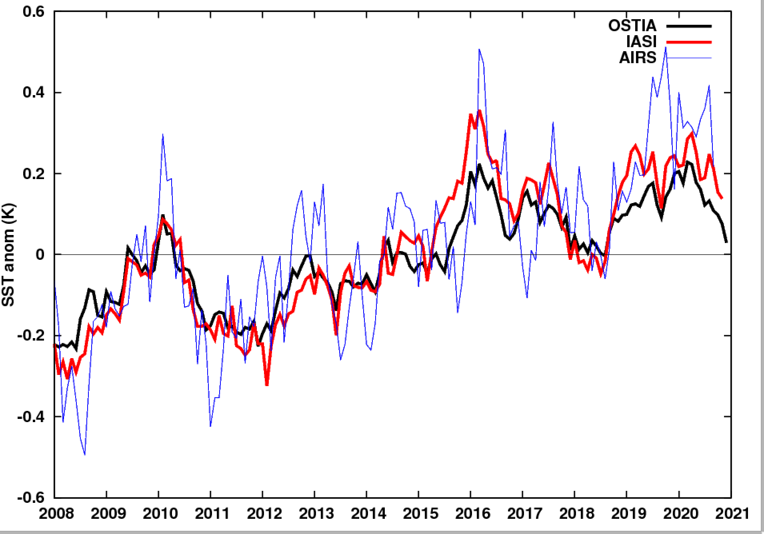
Evolution of the sea surface temperature over the 2007-2020 period
OSTIA: L4 monthly 0.25°x0.25° reanalysis from
AVHRR, AVHRR_GAC, AVHRR_LAC, IASI-L2, SEVIRI, TMI, GOES_Imager, SSMIS, SSM/I
Global temperature anomaly time series (ref=2008-2020)
Regular increase of the temperature since 2008: +0.4K
IASI consistent with OSTIA (but after 2015, IASI anomalies slightly larger than OSTIA) and with AIRS
OSTIA data were provided by GHRSST, Met Office and CMEMS
AIRS: AIRS/Aqua L3 Monthly Standard Physical Retrieval (AIRS-only) 1 degree x 1 degree V006, https://disc.gsfc.nasa.gov/datasets/AIRS3STM_006/summary?keywords=AIRS%20L3

Slide 16
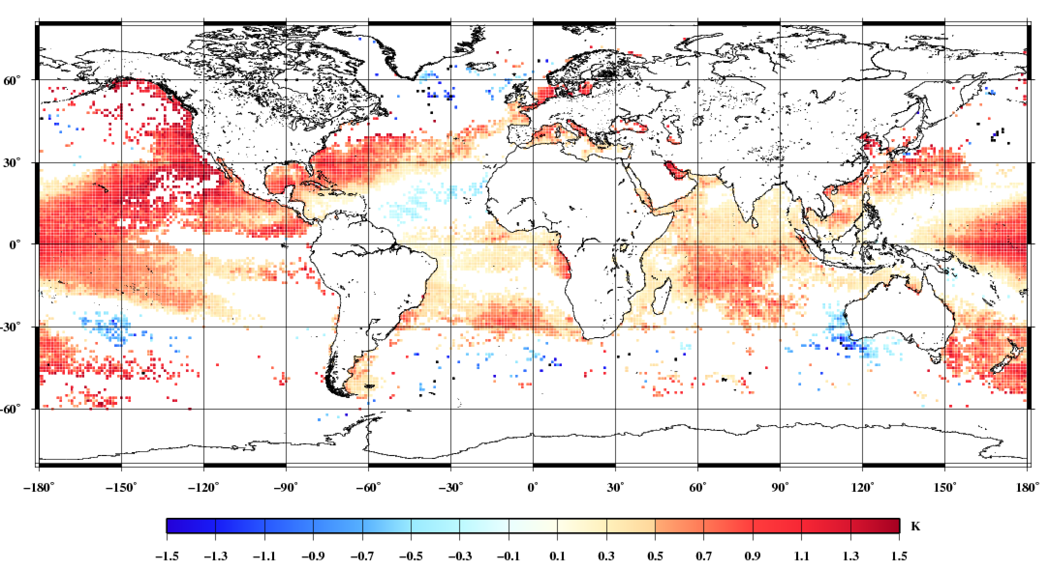
Evolution of the sea surface temperature over the 2007-2020 period
OSTIA: L4 monthly 0.25°x0.25° reanalysis from
AVHRR, AVHRR_GAC, AVHRR_LAC, IASI-L2, SEVIRI, TMI, GOES_Imager, SSMIS, SSM/I
°C.decade⁻¹
﻿1° grid-point resolution IASI trends (decade⁻¹) at the 95% confidence level or more for 2008-2020
Global temperature anomaly time series (ref=2008-2020)
trend >0K over the major part of the Ocean
increase more pronounced for the Pacific
OSTIA data were provided by GHRSST, Met Office and CMEMS
AIRS: AIRS/Aqua L3 Monthly Standard Physical Retrieval (AIRS-only) 1 degree x 1 degree V006, https://disc.gsfc.nasa.gov/datasets/AIRS3STM_006/summary?keywords=AIRS%20L3

Slide 17
Conclusion
A fully physically-based algorithm has been developed to retrieve nighttime IASI sea-surface (skin) temperatures from short wavelengths for climate application
Accuracy (bias) and precision (standard deviation) has been assessed from collocation with drifter (after skin-to-depth temperature conversion)
Robust statistics : Median= -0.024K ; RSD=0.25K (drifter precision-0.2K)
Stability of the time series has also been checked with a deviation < 0.045K.decade-1 (0.025K .decade-1 for Tropics)
The homogeneity of the time series is ensured by the remarkable consistency between the metop series (bias <0.03K and RSD<=0.25K)
Night-time SST from IASI is valuable for climate studies
Can be extended to daytime observation by introducing solar contribution

Slide 18
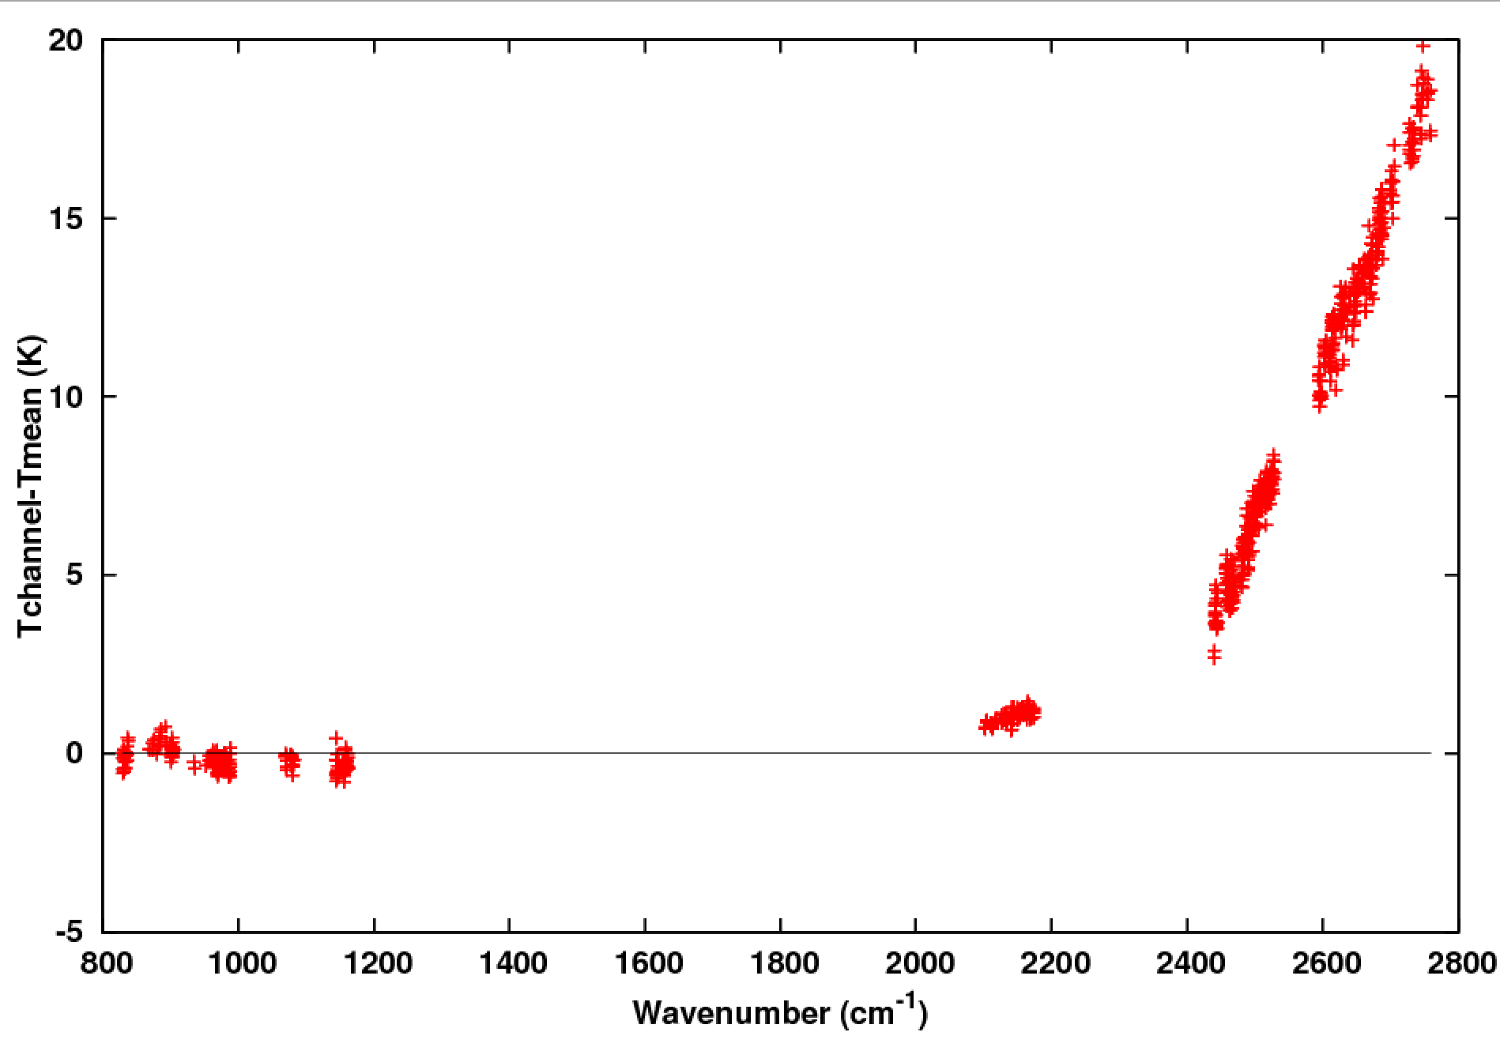
Perspective: daytime extension
Unlike for the radiometers, the numerous “window” channels available with IASI at short wavelengths allow a precise estimation of the solar contribution in the RTE
SST retrieval channel by channel when the solar contribution is not taken into account
The solar contribution in th eRTE depends:
On the geometry sun/satellite
known
On the probaility P of wave slope
Unknown (but exitising parametrizations, e.g. Cox&Munck)
Error of up to 15-20K!
Capelle and Hartmann, subm. to JGR

Slide 19
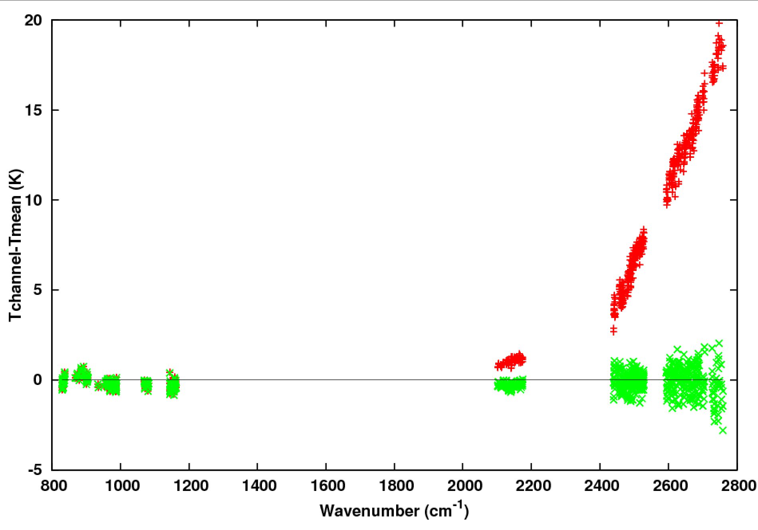
Perspective: daytime extension
Unlike for the radiometers, the numerous “window” channels available with IASI at short wavelengths allow a precise estimation of the solar contribution in the RTE
The solar contribution in th eRTE depends:
On the geometry sun/satellite
known
On the probaility P of wave slope
Unknown (but exitising parametrizations, e.g. Cox&Munck)
Ts and P are determined simultaneously by least square method
solar contribution is not taken into account
Solar contribution taken into account
Capelle and Hartmann, subm. to JGR

Slide 20
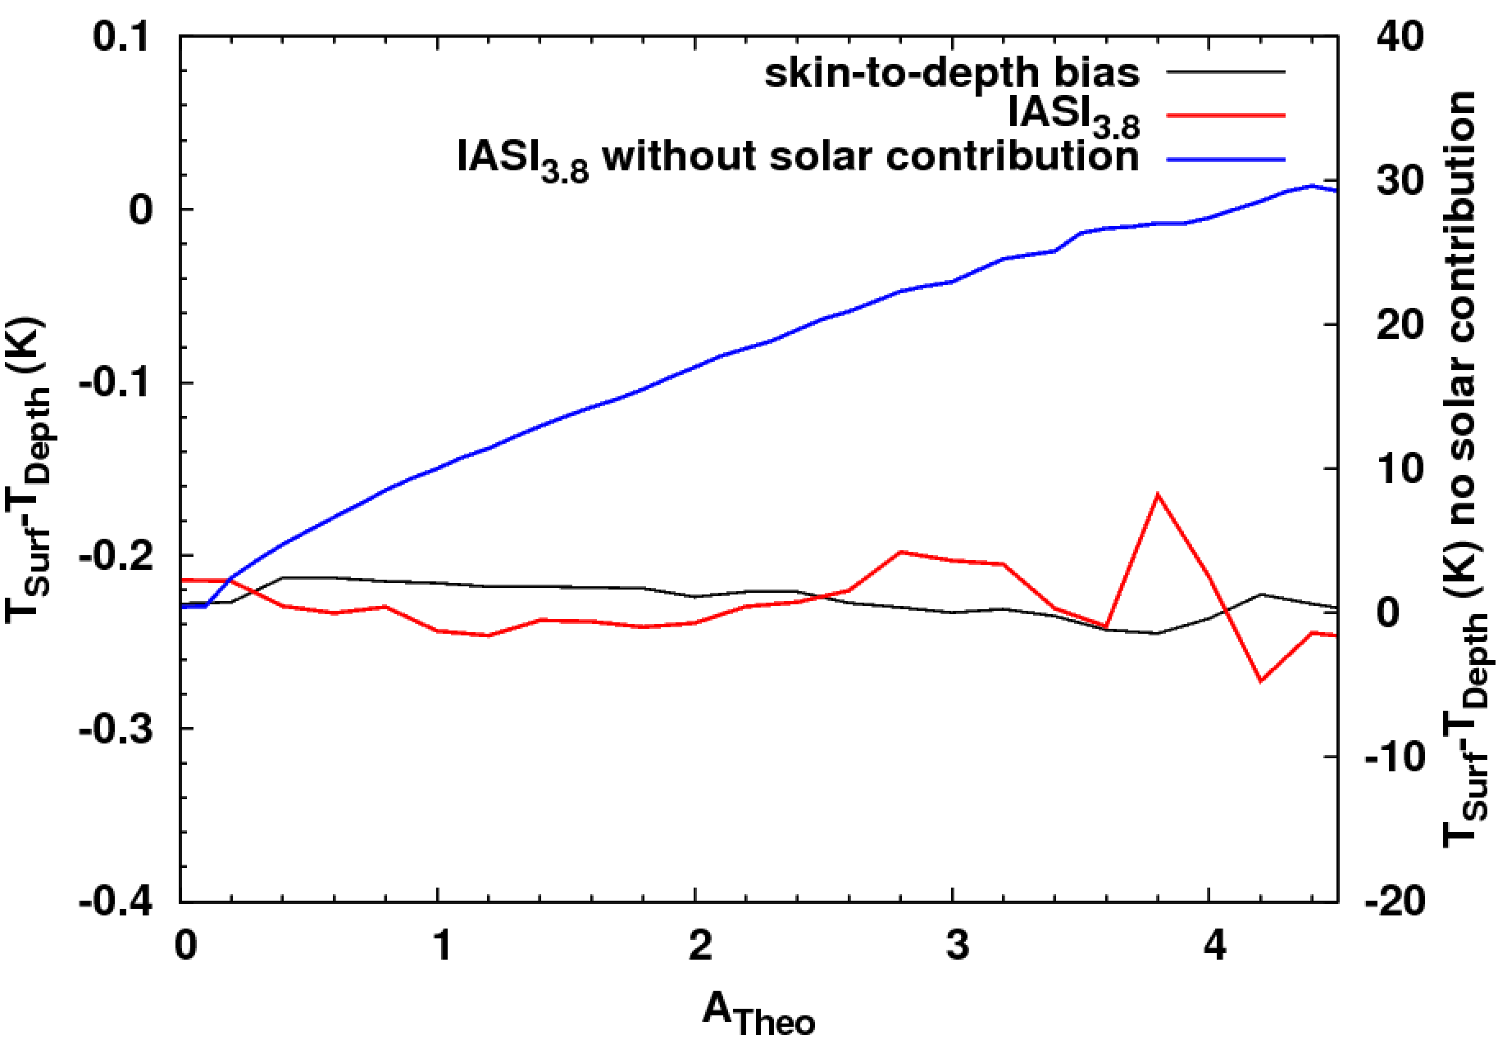
Perspective: daytime extension
Unlike for the radiometers, the numerous “window” channels available with IASI at short wavelengths allow a precise estimation of the solar contribution in the RTE
Comparison with drifter, in function of solar contribution
Robust statistics of IASI converted to depth vs drifter temperature
 | All situations | A<0.5 (« night » case) | A>1
Median (K) | 0.01 | 0.02 | -0.01
RSD (K) | 0.3 | 0.29 | 0.33
Solar contribution correctly taken into account
I ASI bias compared to drifters similar to nightime bias
== solar contribution

Slide 21
Back-up slides

Slide 22
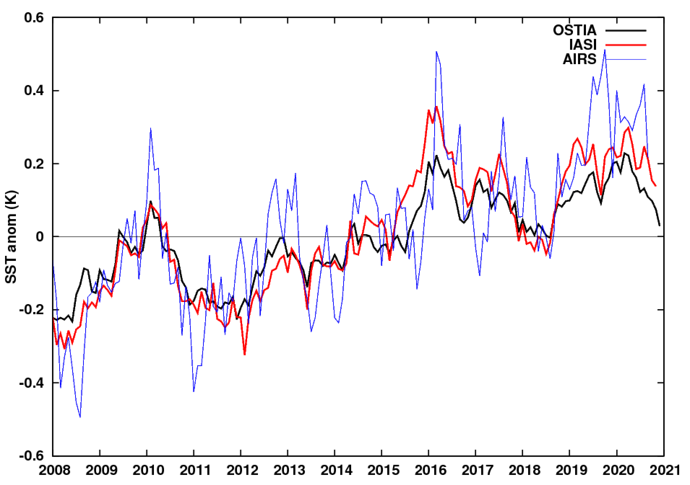
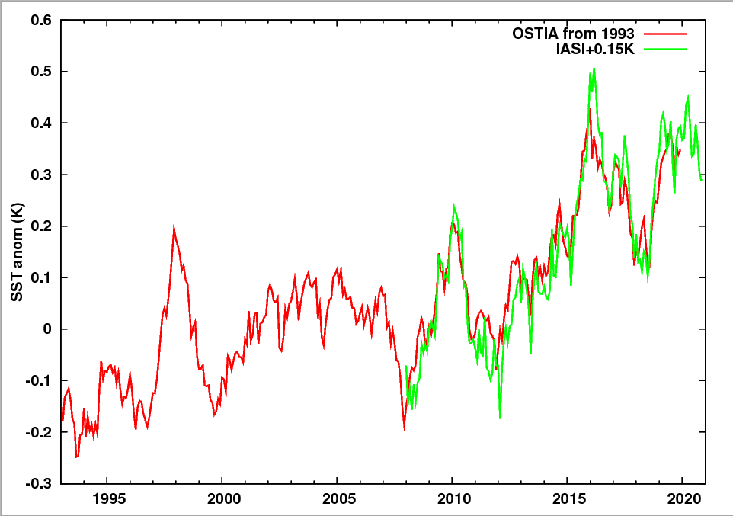
Evolution of the sea surface temperature over the 2007-2020 period
1993-2020
OSTIA: L4 monthly 0.25°x0.25° reanalysis from
AVHRR, AVHRR_GAC, AVHRR_LAC, IASI-L2, SEVIRI, TMI, GOES_Imager, SSMIS, SSM/I
Global temperature anomaly time series (ref=2008-2020)
Global temperature anomaly time series (ref=1993-2014)
Regular increase of the temperature since 2008: +0.4K
trend >0K over the major part of the Ocean
increase more prononced for the Pacific
OSTIA data were provided by GHRSST, Met Office and CMEMS
AIRS: AIRS/Aqua L3 Monthly Standard Physical Retrieval (AIRS-only) 1 degree x 1 degree V006, https://disc.gsfc.nasa.gov/datasets/AIRS3STM_006/summary?keywords=AIRS%20L3

Slide 23
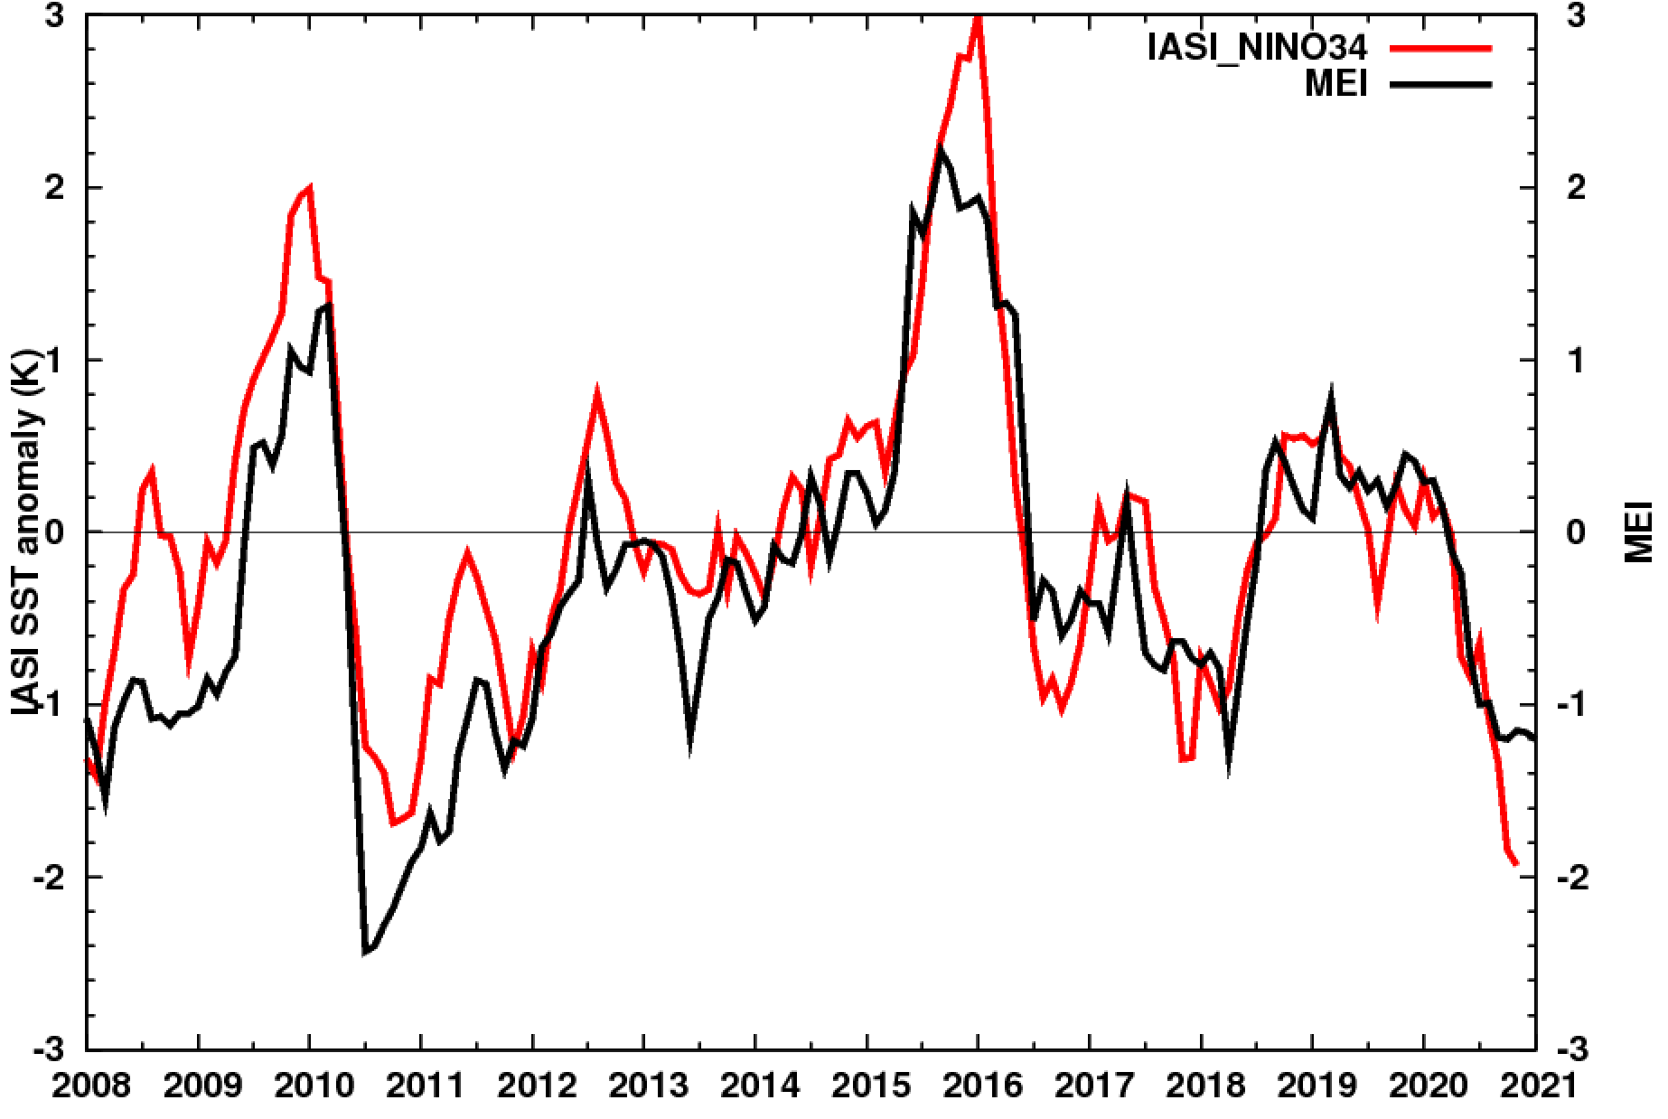
Evolution of the sea surface temperature over the 2007-2020 period
NINO34 region
°C.decade⁻¹
﻿1° grid-point resolution IASI trends (decade⁻¹) at the 95% confidence level or more for 2008-2020
De-trended temperature anomaly time series (ref=2008-2020)
IASI SST (detrend) anomalies for NINO34 region consistent with MEI

